Slide 1
Requirements Analysis for Running Dashboard Tool
Notes:
Before I dive into this presentation, with this being the first presentation of the series dedicated to this project, I want to do a brief introduction:
I’m Justin Campbell, I’m a Computational Engineering alumni from the University of Texas at Austin, an interdisciplinary degree in computer science, statistics, and engineering.
I have four years of experience in data science and software development roles where I’ve utilized my background in computational science and engineering to build backend systems, improve data science workflows, and perform research studies.
Some highlights of my work accomplishments include
refactoring an Excel-driven cost estimation workflow into a Python-based tool with MSSQL Server persistent storage streamlining end-to-end model development workflow
Performing an inferential statistical analysis study of defense contract cost performance strengthening leadership’s ability to monitor program risk and prioritize oversight efforts,containerize and deploy models using Docker and Kubernetes conduct research studies

Slide 2
Personal Background and Experience
Work Experience
Data Scientist, Software Developer, and AWS Certified Solutions Architect with 4 years of experience developing analytical and software solutions in industry and academia.
Background
Computational Engineering alumni of University of Texas at Austin
Highlights
Cost Estimating Relationship Tool that streamlines the end-to-end model development workflow improving model turnaround time, maintainability, and auditability
Inferential Statistical Analysis Study driving insights into cost overruns in defense contracts for program risk management
Notes:
Before I dive into this presentation, with this being the first presentation of the series dedicated to this project, I want to do a brief introduction:
I’m Justin Campbell, I’m a Computational Engineering alumni from the University of Texas at Austin, an interdisciplinary degree in computer science, statistics, and engineering.
I have four years of experience in data science and software development roles where I’ve utilized my background in computational science and engineering to build backend systems, improve data science workflows, and perform research studies.
Some highlights of my work accomplishments include
refactoring an Excel-driven cost estimation workflow into a Python-based tool with MSSQL Server persistent storage streamlining end-to-end model development workflow
Performing an inferential statistical analysis study of defense contract cost performance strengthening leadership’s ability to monitor program risk and prioritize oversight efforts,containerize and deploy models using Docker and Kubernetes conduct research studies

Slide 3


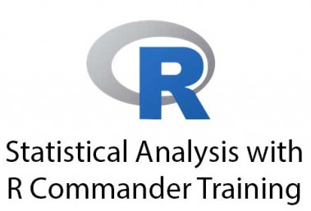








Personal Background and Experience
Technical Toolkit
Programming: Python, SQL, R, C++, Bash
Data & Analytics: Python (Pandas, NumPy, SciPy, Scikit-Learn), R, Jupyter Notebook
Cloud & DevOps: AWS, Docker, Kubernetes, Git/GitHub, Cursor, Claude, GitHub Copilot
Databases & Project Management: Redis NoSQL, MySQL, MSSQL Server, Agile, Jira
Notes:
Here is an overview of the technical skills that I have developed through my education and professional experience.
Out of interest in time, I won’t run through each, but I’ve categorized them to emphasize that I can operate at the intersection of data science and software engineering with mention of scripting and compiled languages, cloud infrastructure and distributed computing software, database technologies, and software versioning and management tools.

Slide 4

Why Perform Requirements Analysis?
Background: Project is being developed as a solo-effort with no mandatory requirements, milestones, or deliverables
Initial Status: Initial documentation of requirements in the task plan represents a collection of initial ideas for the design and function of the system
Purpose:
Constrain the scope of the project into a smaller list of requirements that are more achievable and timely
Categorize list of requirements to enable prioritization
Investigate trade-offs to be informed of future design decisions and their impacts
Notes:
Transitioning to the project, so, why perform requirements analysis in the first place?
Well, firstly, this project is being developed as an individual effort with no formal requirements, milestones, or deliverables that need be satisfied.
The initial documentation of requirements in the task plan is a lengthy list of both needs and wants for the tool representing an unbounded collection of initial ideas for the design and function of the system
In order to develop a running tool that satisfies the use case of being a general-purpose tool to provide users with data-driven insights and forecasts into running performance, the purpose was threefold:
the scope of the task needed to be constrained into a set of requirements that are more achievable, and timely
The list of requirements needed to be further categorized into needs and wants to better prioritize the development effort moving forward
Trade-offs in implementing requirements needed to be considered in detail to be aware of implications on future design, development, and testing decisions

Slide 5

How was this accomplished?
Initial review performed to separate finalized requirements from requirements for further analysis
Trade-offs established for individual requirements
Trade Spaces developed for each requirement type (functional vs technical, needs vs wants)
Requirements down-selected using trade space analyses
Requirements Decision Matrices developed to visualize association between customer satisfaction and technical difficulty
Notes:
How was this requirements analysis performed?
First, a review over the initial set of the requirements was performed and those deemed necessary were down-selected as final and separated from those for further consideration.
Then, amongst the requirements for further consideration, trade-offs regarding the likely impact of implementing on the system were investigated
From here, trade-offs for each requirement were used to established trade spaces by requirement type (technical needs, technical wants, functional needs, and functional wants). These trade spaces were used to convey trade-offs impacting the requirements at the category level to examine trade-off coverage on the requirements (to what degree are the requirements impacted by these trade-offs)
From here, insights from the trade spaces were used to down-selected requirements into final technical/functional needs and wants designations (where some needs were re-prioritized as wants and vice-versa)
Then, requirements decision matrices were assembled to visualize the association between needs and wants and the likely technical difficulty in satisfying those requirements.

Slide 6
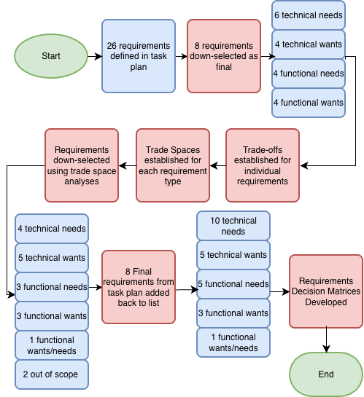
Requirements Analysis Process
Notes:
This slide is used to visualize the top-down requirements analysis process.
At project inception, 26 unique requirements were documented into technical and functional categories and further compartmentalized into needs and wants.
After an initial review, 8 requirements were down-selected as final without considering trade-offs as concrete needs for the project.
This left 6 technical needs, 4 technical wants, 4 functional needs, and 4 functional wants to be reviewed further.
To accomplish this, trade-offs were then established for the implementation of individual requirements considering properties such as user experience, performance, and maintainability.
From here, overarching trade spaces were developed for each requirement type (i.e. technical needs, technical wants, functional needs, and functional wants) to consider trends in how requirement implementation would be impacted by trade-offs across categories. This involved documenting requirement strengths and limitations, trade-off relationships, and compromise schematics.
Trade space analyses was performed by down-selecting requirements as needs, wants, or out of scope using these insights producing the breakdown of requirements shown here.
The eight requirements that were down-selected at the beginning of requirements analyses were then added back into the list to produce this final breakdown of requirements.
Lastly, requirements decision matrices were developed to visualize the final categorization of requirements to better convey priorities moving forward.

Slide 7
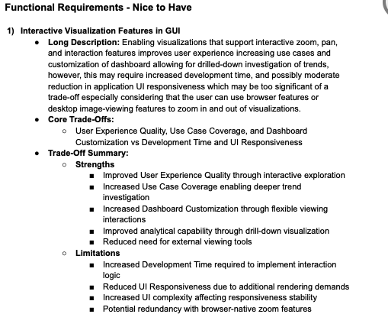
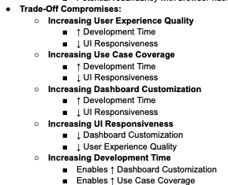
Analysis for Example Requirement: Step #1:Trade-offs for Individual Requirements
Notes:
To track the steps of the analyses on a requirement level, let’s drill-down to an example requirement and walk through each step of the analyses process.
Taking the first functional requirement “interactive visualization features in GUI” as an example: a long description is provided that addresses the scope of the requirement through mention of trade-offs along with the likely impacts of implementing or not implementing the requirement on the system. [READ LONG DESCRIPTION]. This is an unstructured summary of the expected impacts.
In the next section, the core trade-offs from this “Long Description” section are listed.
And in the trade-off summary section, we have more structured list of the trade-offs through the lens of strengths and weaknesses of implementing this requirement in the system
[READ trade-off summary section]
Lastly, over on the right, we have compromises which convey the relationships between the trade-offs
[For example, increasing user experience quality through interactive components and dashboard use case coverage would indirectly require greater development time and decrease UI responsiveness through additional rendering cycles and backend-frontend logic].

Slide 8
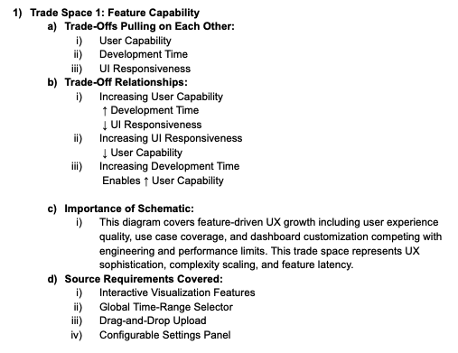
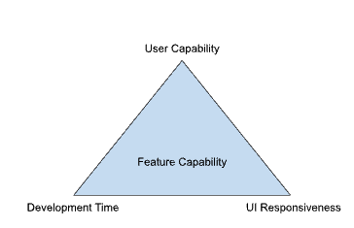
Step #2: Trade Spaces Established for each Requirement Type
Notes:
Step #2 was to review trade-offs for requirements by category (i.e. technical wants, technical needs, functional wants, and functional needs) and this was performed by developing trade spaces spanning trade-offs in the requirement for each of those categories.
Continuing with the requirement in the example, the predominant trade-space for this requirement was “Feature Capability” which covers trade-offs of user capability, development time, and UI responsiveness.
Trade-Off relationships characterizing how the trade-offs pull on each other were documented but this time at the “trade space level” or generalized for each requirement type, not specific requirements.
For this example, this can be interpreted as, for requirements with feature capability implications, increasing the user capability (quantity and quality of features in the dashboard tool) comes at the expense of increased development time, and a decrease in the responsiveness of the UI.
A brief description on the scope and importance of the trade space schematic was provided: [READ]
And finally, the requirements with implications on the trade space in the associated requirements category (here: functional wants with implications on Feature Capability) were documented.
Now, for other requirements initially designated as functional wants, the trade-off analyses involved consideration of a second trade space, “Interface Space” in conjunction with this trade space compromises to down-select. An identical process was used for the other three requirement categories where as many as three trade spaces were assembled to weigh trade-offs for each category.

Slide 9
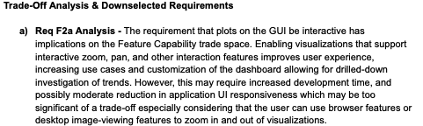


Step #3: Requirements Down-Selected using Trade Space Analysis
Notes:
In step #3, the requirements were down-selected using insights from the trade space analysis.
Continuing with the example of analysis on the requirement that the GUI support interactive plotting features,
It was before, an important note that this has implications on the Feature Capability trade space. Enabling visualizations that support interactive zoom, pan, and other interaction features improves user experience increasing use cases and customization of dashboard allowing for drilled-down investigation of trends. However, this may require increased development time, and possible reduction in application UI responsiveness.
Ultimately, the Decision - Since enabling interactivity in the visualizations adds little benefit to the utility of the dashboard, would decrease UI responsiveness, require additional development time, and can be substituted for native image viewing tools, this requirement is being down-selected as a want.
Now, for other requirements initially designated as functional wants, the trade-off analyses involved consideration of a second trade space, “Interface Space” in conjunction with this trade space compromises to down-select. An identical process was used for the other three requirement categories.

Slide 10
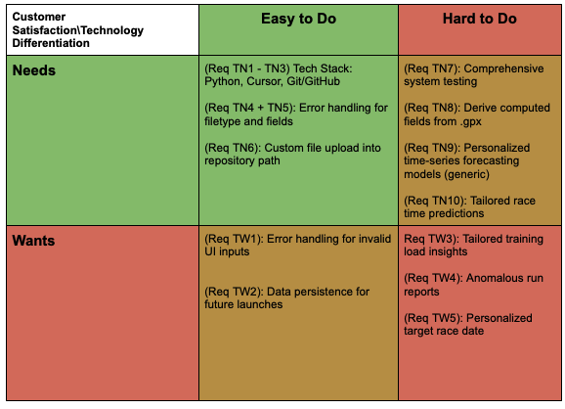
Technical Requirements Decision Matrix
Notes:
In this slide, we have one of two requirements decision matrices, the technical decision matrix developed to visualize the association between customer satisfaction level (needs vs wants) and technological differentiation (easy vs hard to accomplish technically). Therefore, this visualization takes the one-dimensional listing of requirements by requirement type and maps it into a two-dimensional space where requirements can be more succinctly viewed and prioritized.
[READ THROUGH EACH SQUARE]

Slide 11
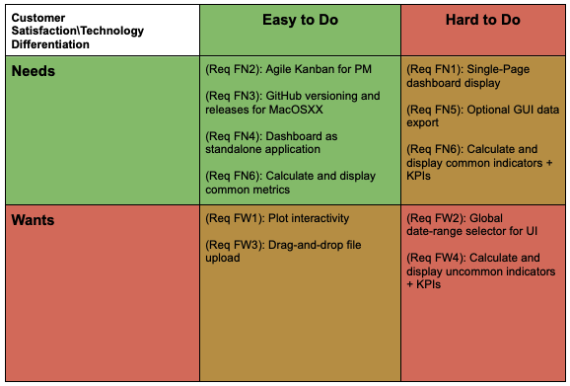
Functional Requirements Decision Matrix
Notes:
The functional requirements decision matrix was developed in the same way.
[READ THROUGH EACH SQUARE]

Slide 12
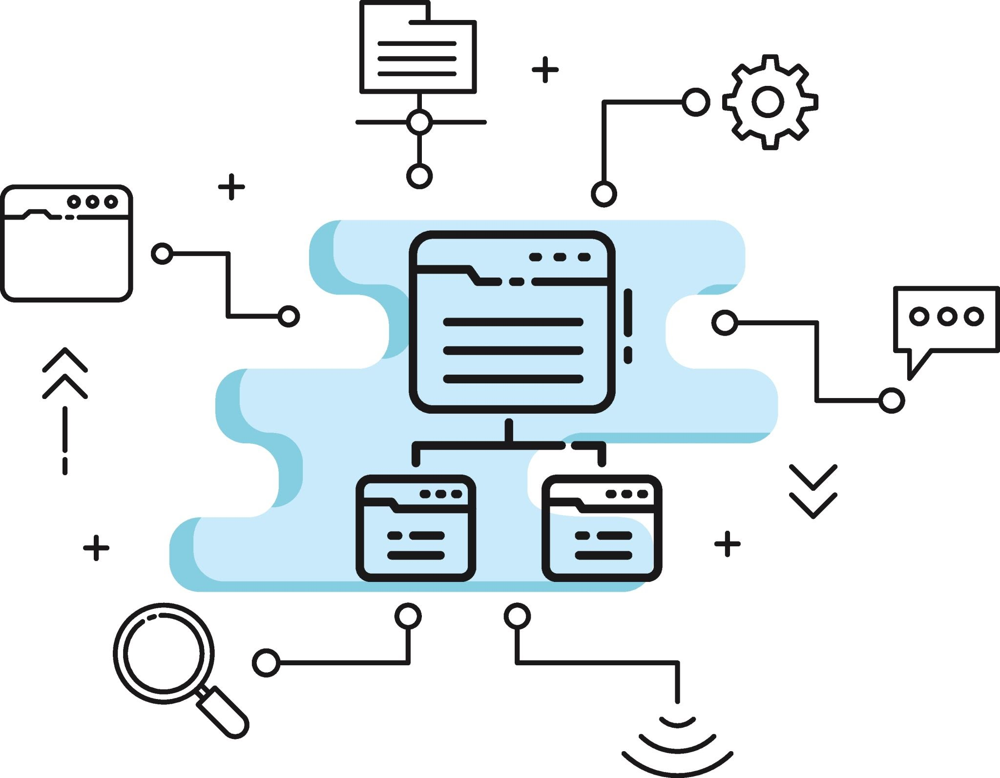
Next Steps
Preliminary System Design (Platform-Agnostic)
Black Box Diagrams
Use Case Workflows
System Architectural Diagrams
UI Designs
Feasibility Analysis Studies
Define categories and sub-categories
Perform Literature Review to assemble competing alternatives
Define Feasibility Analysis methodology
Define and weigh Feasibility Analysis criteria
Perform analysis to down-select alternatives
Notes:
After performing requirements analysis, the next step is to begin ideating system architectural designs and application workflows which will involve:
Developing platform agnostic black box diagrams to characterize inputs, outputs, and internal processes in the application and its subsystems
Flowcharts that convey the workflows of common use cases when operating the system following the user from initial launch through dashboard display and data export
System architectural diagrams that illustrate the technical components within and between subsystems and their integration
And UI designs that convey the visual layout on a state-by-state basis for common use cases.
Then, a Feasibility Analysis Studies will be performed to identify and down-select competing alternative technical design ideas including software libraries/frameworks, system architectural designs, etc. from which to develop detailed system designs.

